Slide 1
Intern Learning Output web crawling
By: Aldo Sanjoto

Slide 2
Flow chart:
Python Code
Run in LINUX (CentOS)
Cron job
Input to Database (Ex: Pattimura)

Slide 3
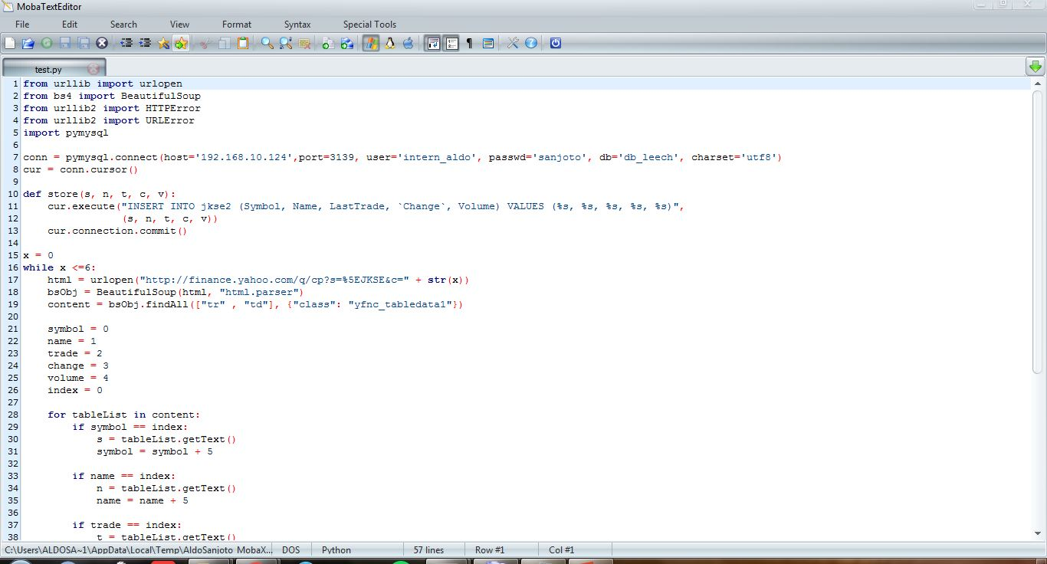
Python Code:
This code takes Jakarta Component Index (JKSE) from Yahoo Finance website.
url: http://finance.yahoo.com/q/cp?s=%5EJKSE+Components

Slide 4
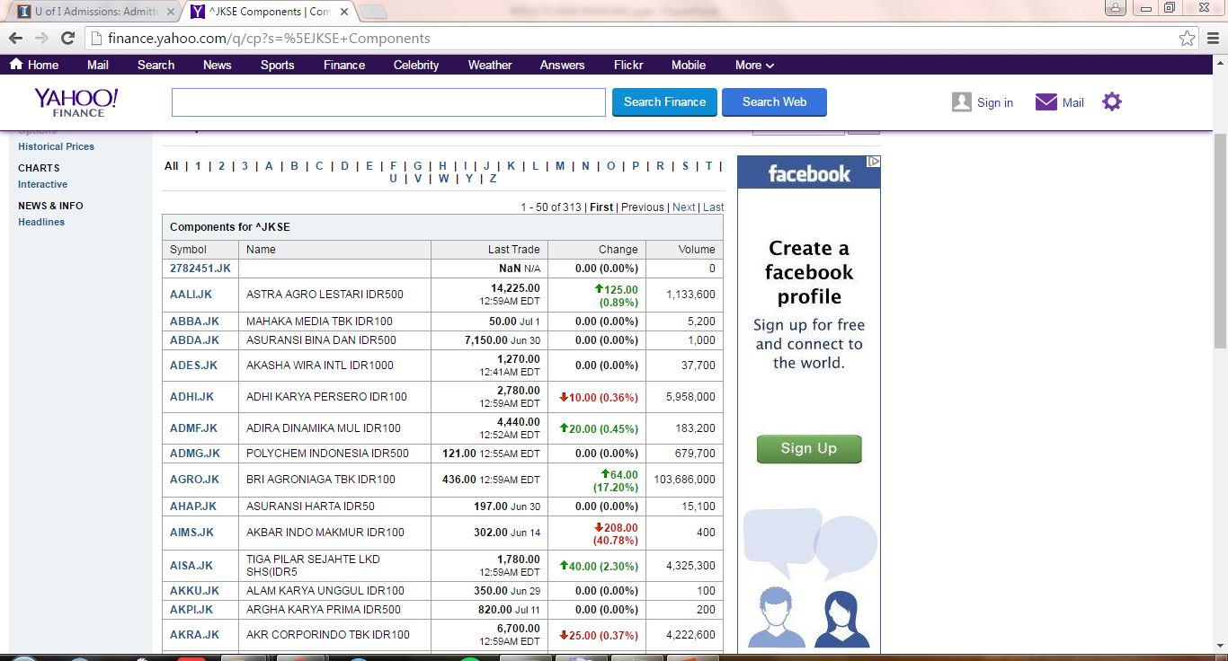
Yahoo Finance Page:

Slide 5
Run in Linux server: Why? Because we want to make Cron Job so that it can run according to our schedule needs. For instance, every Friday at 12pm.

Slide 6
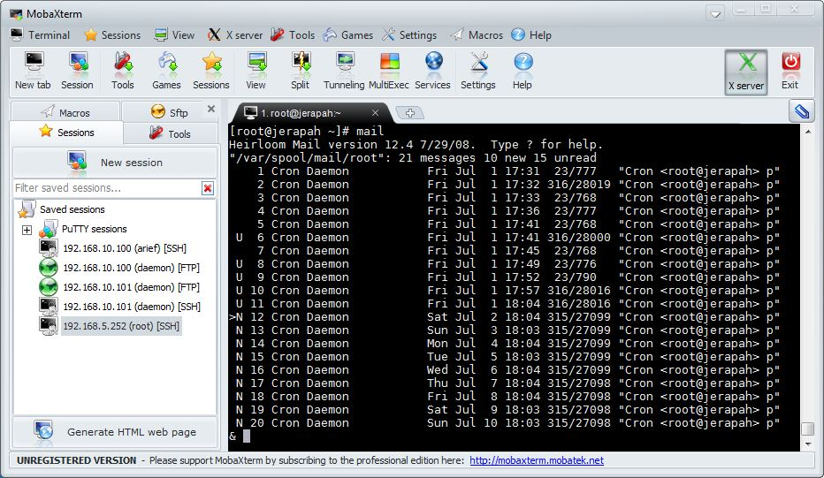
CronJob: Everyday at 18:03

Slide 7
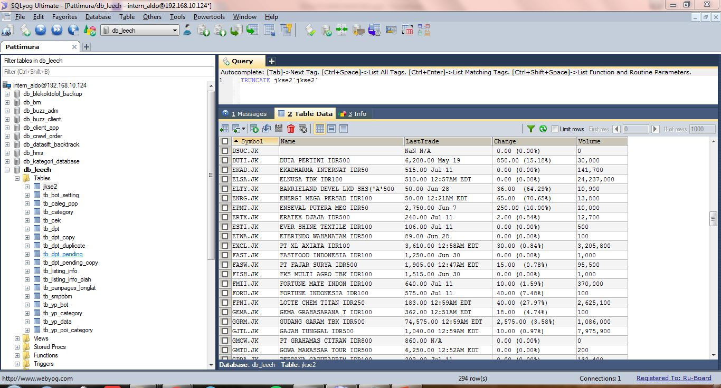
Input to database: Pattimura

